Slide 1

CE7454 Project: Simultaneous Prediction of Box-ofﬁce and Movie Rating using Multimodal Neural Network
Group 26: Li Jie, Shen Meng, Wang Ruihang
School of Computer Science and Engineering
Nov 2019

Slide 2
Outline of This Slides
Project Introduction
Data Acquisition
Data Cleaning
Deep Learning Network
Results Analysis

Slide 3
Project Introduction
Consumer Side
Movie rating is an important factor to measure the quality of a movie
Producer Side
They make movies to earn revenues
Our Solution: Predict both two factors using Deep Learning
Notes:
In modern file industry, movie has already been a part of our life
rating is an important factor to measure the quality of a movie.
In this project, we are interested in predicting both box-ofﬁce revenue and movie rating in an early stage, aiming to provide useful information for producers, distributors and viewers.

Slide 4
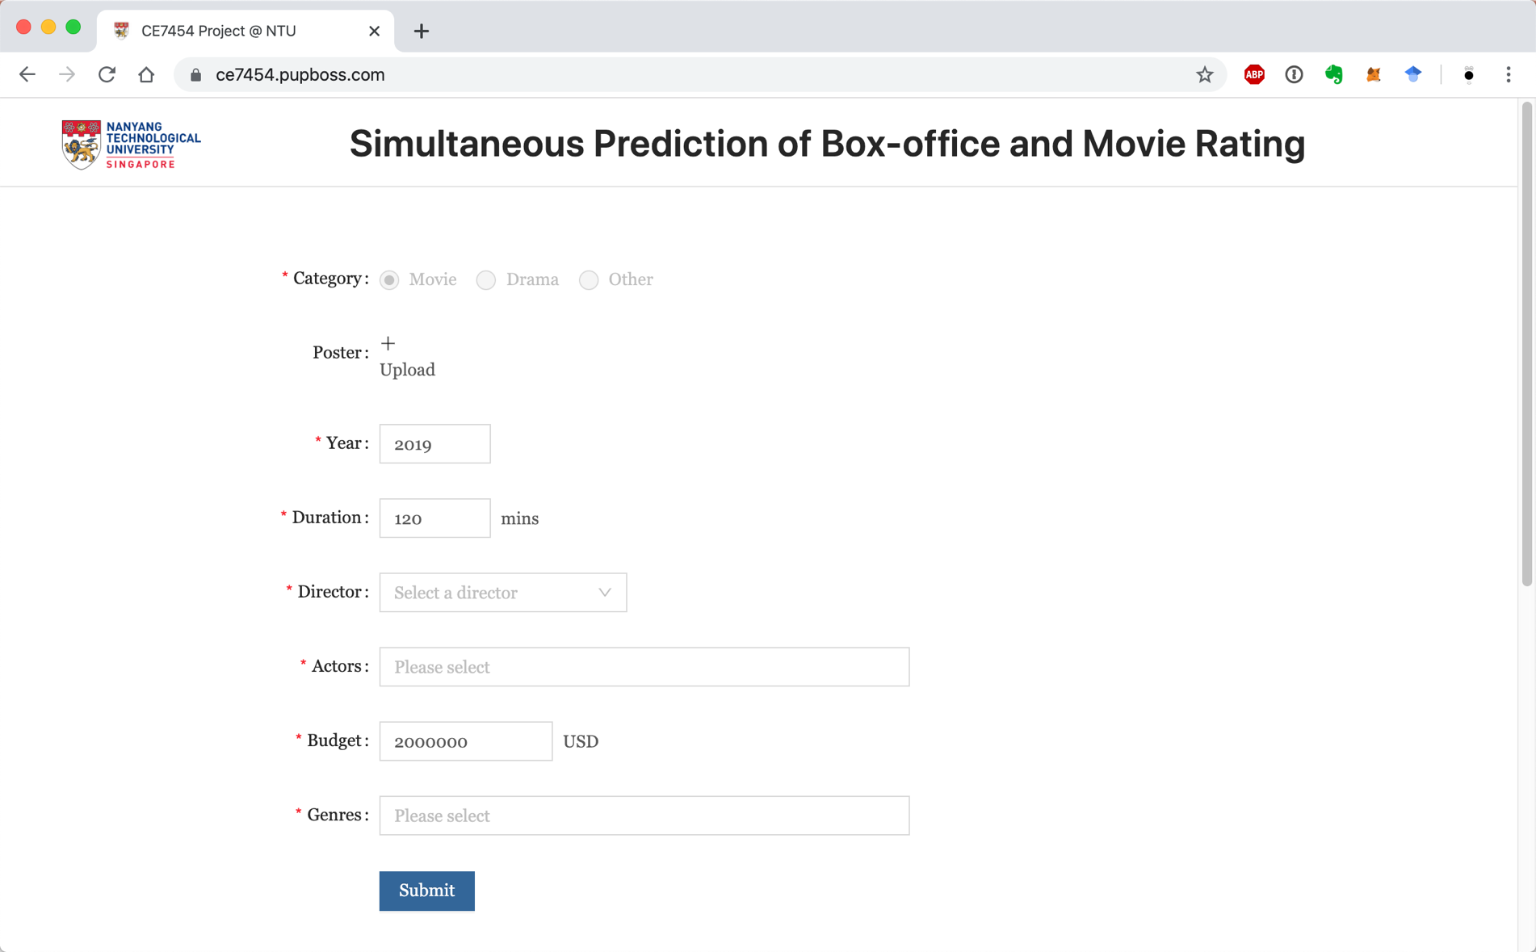
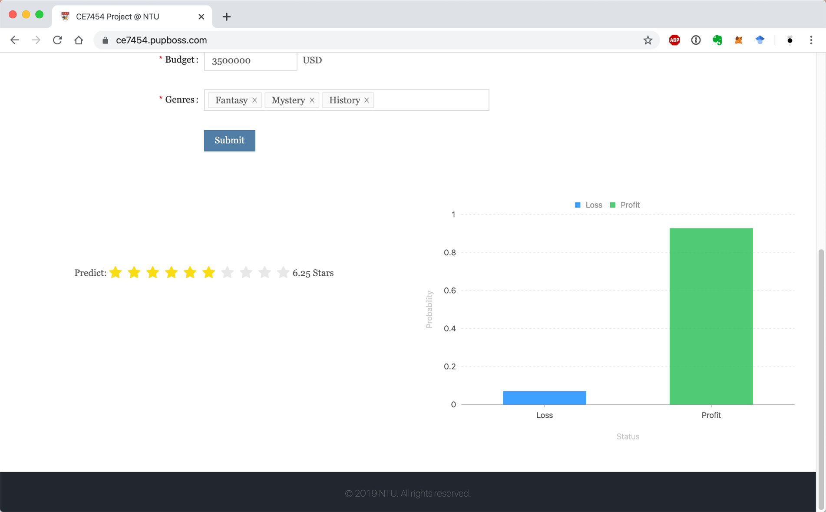
An Online Demo for Box-office Prediction
Website URL: https://ce7454.pupboss.com

Slide 5
Data Acquisition
Data Source:
IMDb official website
Crawler
Technologies in use
Python, Pandas, PyQuery, requests
Data Acquisition
Collected 8278 records including:
Titles, Budgets, Box Offices, Years, Directors, Actors, Ratings etc.
Notes:
IMDb provides xxxx, so xxx, but xxxxx, we have to develop our own crawler
Python is a well-known programming language, Pandas is used for data filtering and xxx, PyQuery is for parsing HTML doms, requests will be used in images downloading
Finally, we collected xxxx

Slide 6
Data Cleaning

Slide 7
Deep Learning Network

Slide 8
Results Analysis

Slide 9
Everyone’s Contribution
Project Proposal: Li Jie, Wang Ruihang, Shen Meng
Crawler Development: Shen Meng, Li Jie
Data Cleaning: Shen Meng, Li Jie, Wang Ruihang
Network Design: Wang Ruihang, Shen Meng
Data Analytics: Wang Ruihang
Online Demo and backend: Li Jie

Slide 10

THANKS

